Slide 1

Labour Exploitation in Migrant Communities
Recognising signs | Responding safely | Providing support
Last updated: June 2023
Part Two

Slide 2

Responding to Concerns or Disclosures

Slide 3

Key Steps
Recognise Signs
Reduce Risk
Respond Safely
Refer

Slide 4

Good Practice Principles
Whatever our role, it is important to be guided by good practice principles and respond in a way that is safe, ethical and respects the dignity and rights of the person at risk of labour exploitation.
SAFETY
Interventions focus on minimising risks and not exposing the person to any harm.
CONFIDENTIALITY
Upholding the privacy and anonymity of the person as much as possible.

Slide 5
STRENGTHS-BASED
Recognising the person's unique strengths and skills and supporting them to build their abilities and confidence.
PERSON-CENTRED
Respecting the person's wishes, rights, and dignity. Support is tailored to their needs and priorities.
INFORMED
CONSENT
Equipping the person with relevant knowledge to assist them in making decisions and taking actions.
COLLABORATION
Working together with the person and other services to promote optimal outcomes.

Slide 6
Examples of Good Practice Principles
Which principles do the following examples represent?
Making referrals based on the needs of the person, rather than making decisions on their behalf.
PERSON-CENTRED
Not sharing information about the person to an external service, unless you have their consent.
CONFIDENTIALITY

Slide 7
Which principles do the following examples represent?
Letting the person know about the benefits and potential impacts they might experience if they choose to engage with a particular service.
INFORMED
CONSENT
Creating a safe and calm environment to meet with the person, to reduce the risk of re-traumatisation.
SAFETY

Slide 8

Discussing Exploitation
It is important to have conversations about the person's situation in a respectful and sensitive way.
Practice Considerations
Active Listening: listening attentively in a non-judgemental way while the person speaks and paraphrasing or reflecting back what is said.
Relevance of information: asking questions that are necessary and appropriate, and gathering information that is relevant.
Allowing flexibility: if the person is not ready or willing to talk, informing them of how they can contact you at a later stage if they want to.
Open questions: employing open questions to allow the person to shape how they share their story.

Slide 9
Barriers to Seeking Help
People who have experienced labour exploitation may be reluctant to seek help or share their experiences due to variety of reasons and barriers.
Fear of deportation or arrest
Shame, manipulation or intimidation
Lack of awareness of rights and available pathways for support
Difficulties in discussing sensitive/taboo topics like exploitation
Concerns for the safety of loved ones
Language barriers
Social isolation
Mental health issues including trauma
Potential loss of income and livelihood
Mistrust of authorities

Slide 10
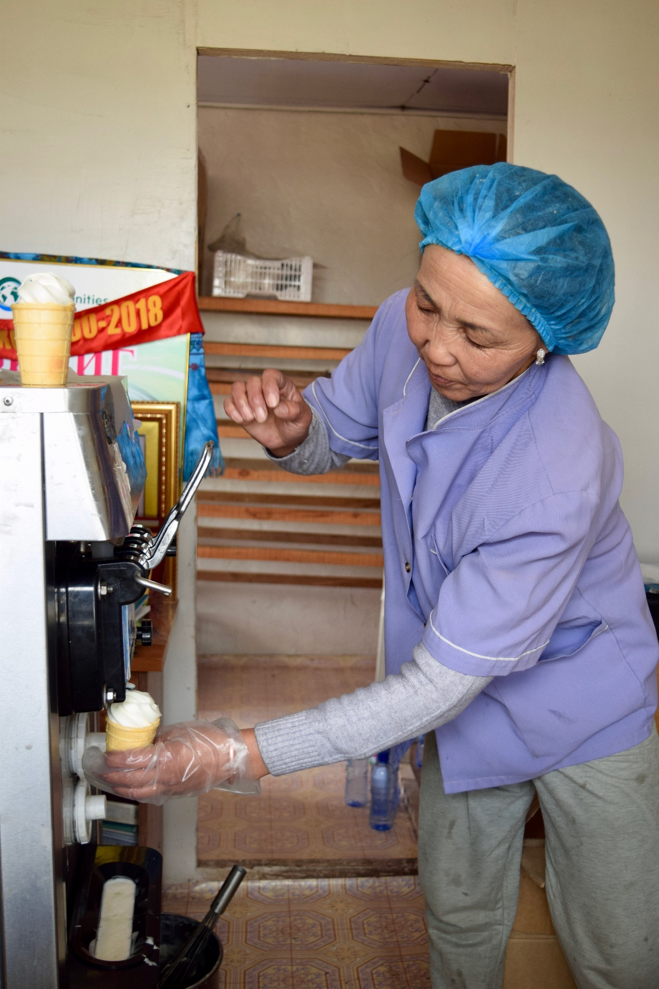
Reducing Risk
Assessing Risks, Needs & Strengths

Slide 11
Assessing Risks, Needs & Strengths
When responding to concerns or disclosures of exploitation, it is important to develop a holistic understanding of the person's situation by assessing risks, needs, strengths and protective factors. This is an ongoing process, as these factors are likely to shift and change over time.
Risks
Factors that could immediately or eventually endanger the person or cause further harm.
Key questions to assess the significance of a risk:
        How likely is it to happen?
        How significant would the consequence be if it did happen?

Slide 12
Needs
The person may have a range of immediate, short-term and long-term needs.
Immediate needs are generally satisfied as a priority before addressing more long-term matters higher up the pyramid.
long-term
short-term
immediate
Strengths or Protective Factors
These factors might reduce risk and act as a source of protection for the person (e.g. personal qualities, knowledge, relationships, access to supports).

Slide 13
Examples
Risks | Needs | Strengths / Protective Factors
Deportation | Legal advice | Awareness of legal services
Distress | Psychological wellbeing | Strong family bonds
Loss of income | Financial stability | Eligible for Centrelink
Food insecurity | Material aid | Access to food bank
Homelessness | Stable housing | Alternative housing available
Physical harm | Safety | Safety plan in place
Substance addiction | Healthcare | Willingness to seek help

Slide 14

Case study | Ahmed
Ahmed visits your drop-in service and is looking for financial aid. He states that he has been working but does not earn enough to pay rent. When asked about his financial situation, he shares that he is currently repaying a debt to his employer, who has threatened to deport him if he stops making repayments. He shares that the employer is also violent towards him if he refuses to work, which has resulted in some minor injuries.
Ahmed's visa has expired, and he is afraid to report his employer, as he is not sure what his rights are in the workplace. He is also living with his employer, so he doesn't want to jeopardise his housing arrangement. Ahmed shares that he might have a friend who could offer him a room to stay if needed, but he needs money to get medical treatment for his injuries. He shares that he is willing to visit different services for assistance.
Key questions
  What risks, needs and strengths/protective factors can you identify?
  Does this sound like poor work conditions or modern slavery?

Slide 15
What risks, needs and strengths/ protective factors can you identify?
Risks | Needs | Strengths / Protective Factors
Threats Physical harm Deportation Homelessness Health issues | Financial aid Healthcare Legal/immigration advice | Social connections Alternative housing Willingness to seek help

Slide 16
Responding Safely

Slide 17
Safety Planning
Safety planning is the process of identifying strategies to promote safety for the person at risk of exploitation, and the services involved in supporting them. Safety planning is mainly informed by an individual's assessment of their risk factors and developed through a process of collaboration with the person providing a response.

Slide 18
Strategies to promote safety can include:
Providing emergency contact numbers and details of support services.
Identifying friends or family members who could assist in the event of an emergency.
Sharing concerns with a supervisor and escalating issues in a timely way.
Discussing a safe location the person to go to if they are in danger.
Identifying a secure place for the person to store valuables in case they need to access them immediately.
Choosing safe methods to communicate with the person (e.g. emails rather than texts).
Discussing cyber/online safety (e.g turning off location settings, getting a new phone and number if possible, changing passwords for all online accounts).
Planning measures to protect any children involved.

Slide 19
Case study | Ahmed
Ahmed visits your drop-in service and is looking for financial aid. He states that he has been working but does not earn enough to pay rent. When asked about his financial situation, he shares that he is currently repaying a debt to his employer, who has threatened to deport him if he stops making repayments. He shares that the employer is also violent towards him if he refuses to work, which has resulted in some minor injuries.
Ahmed's visa has expired, and he is afraid to report his employer, as he is not sure what his rights are in the workplace. He is also living with his employer, so he doesn't want to jeopardise his housing arrangement. Ahmed shares that he might have a friend who could offer him a room to stay if needed, but he needs money to get medical treatment for his injuries. He shares that he is willing to visit different services for assistance.
Key questions
  What strategies would you suggest to promote Ahmed's safety in this situation?
  What information would you provide Ahmed?

Slide 20
Strategies to promote safety:
Identifying friends or family members who could assist Ahmed.
Connecting Ahmed with free or affordable healthcare.
Giving contact details of emergency services.
Details of services that provide immigration and legal advice.
Discussing a safe location Ahmed to go to or store valuables if he is in danger.
Escalating any issues to a manager or supervisor.
Identifying what methods of communication he feels comfortable with.

Slide 21

Response Pathways & Referrals

Slide 22

Making Referrals
Making referrals to appropriate service providers is a key step in connecting individuals with relevant assistance.
It is vital that this process is voluntary and shaped by the person, to promote strengths-based approaches and informed consent.

Slide 23
Practice Considerations
Communicating the role of services and what referral processes may look like.
Documenting consent where appropriate.
Services offered are tailored to the person's immediate, short-term and long-term needs.
Selecting credible and professional services.
Confirming eligibility criteria with services prior to making referrals.
Following up with the person to see how their experience has been with the service.
Storing information about the referral in a safe, ethical and confidential manner.

Slide 24
Key Agencies

Slide 25

Fair Work Ombudsman (FWO)
The FWO protects and enforces workplace rights in Australia, and supports workers, employers, and the broader community to understand and comply with legislation. The FWO only supports people in poor work conditions and is unable to directly help in instances of modern slavery.
Services provided
Free and confidential advice on workplace obligations and rights: 131 394 (Infoline)
Site visits to workplaces to inspect work conditions.
Resources on a range of workplace rights and issues translated in various languages: www.fairwork.gov.au
Tools & links
Pay & conditions calculator: https://calculate.fairwork.gov.au/
Find my award link: https://www.fairwork.gov.au/awards-and-agreements/awards/find-my-award/
Online anonymous reporting tool: www.fairwork.gov.au/workplace-problems/send-us-an-anonymous-tip-off
Record My Hours app – available for download from iTunes or Google Play stores.

Slide 26


Legal Aid
Legal Aid provides a range of free legal services in each state and territory on various issues including employment matters. Legal Aid offers advice and representation to anyone who meets its means and merits test criteria.
Links to state/territory Legal Aid Commissions: https://www.nationallegalaid.org/for-individuals/
Safe Work Australia
Safe Work Australia is a national government agency that oversees work health and safety, and workers’ compensation arrangements. State & Territory Safe Work Agencies are responsible for inspecting workplaces and enforcing work health and safety laws.
    SafeWork SA
    WorkSafe ACT
    NT WorkSafe
    WorkSafe Tasmania
    SafeWork NSW
    WorkSafe Victoria
    Workplace Health and Safety Queensland
    Department of Mines, Industry Regulation and Safety (WA)

Slide 27


Australian Federal Police (AFP)
The AFP investigates cases of modern slavery and can refer suspected cases to the Australian Red Cross for community support. The AFP also delivers initiatives to raise awareness of modern slavery practices.
        Free and confidential reporting hotline: 131 237
        Information on reporting: https://www.afp.gov.au/what-we-do/crime-types/human-trafficking
Anti-Slavery Australia (ASA)
Anti-Slavery Australia is a legal centre at the University of Technology that provides free, confidential legal advice and representation to people at risk of or in modern slavery. ASA offers advice on various issues including immigration, employment law, family law, and victim's compensation. ASA also conducts research, advocates for law reform, and delivers training on modern slavery.
        Phone: 02 9514 8115
        Website: https://antislavery.org.au
        Free online course: https://antislavery.org.au/training-advisory/#e-learning

Slide 28
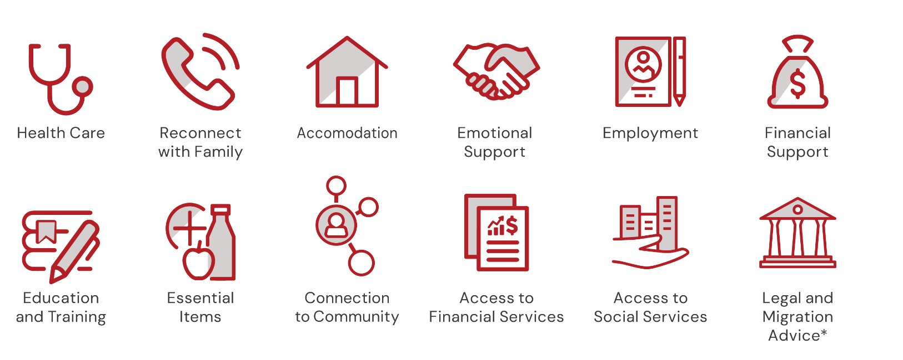
Australian Red Cross
Australian Red Cross delivers the Support for Trafficked People Program (STPP) and supports people who have experienced modern slavery. The STPP is a nation-wide program providing casework support. Support includes housing assistance, material aid, links to community supports, and support in accessing services.
Only the Australian Federal Police can refer individuals to the STPP.
1800 113 015 | National_STPP@redcross.org.au
https://www.redcross.org.au/migration/support-for-trafficked-people/

Slide 29

Which agency would you refer to?
Lakshmi thinks she may be experiencing modern slavery, but just wants some free, confidential advice on her options and rights, for example, what will happen to her visa?
Anti-Slavery Australia
Ming is experiencing modern slavery. He wants to report his employer to authorities and have them investigated.
Australian Federal Police
Fatema is experiencing modern slavery. She wants to know what her options are for support.
Australian Red Cross

Slide 30
Which agency would you refer to?
Jasmine is experiencing poor work conditions and unsafe work practices. She would like advice on work health and safety.
Safe work agencies
Mohammad is experiencing poor work conditions. He wants to report his employer to authorities and have them investigated.
Fair Work Ombudsman

Slide 31
Other Agencies and Services
Community Legal Centres
www.clcs.org.au/legal-help/
Australian Unions
1300 486 466 | www.australianunions.org.au
The Fair Work Commission (FWC)
1300 799 675 | www.fwc.gov.au
Australian Human Rights Commission (AHRC)
1300 656 419 | www.humanrights.gov.au
Pacific Australia Labour Mobility (PALM) Scheme Support Service Line
1800 51 51 31 | support@pacificlabourfacility.com.au
Translating and Interpreting Service (TIS National)
131 450 | www.tisnational.gov.au

Slide 32
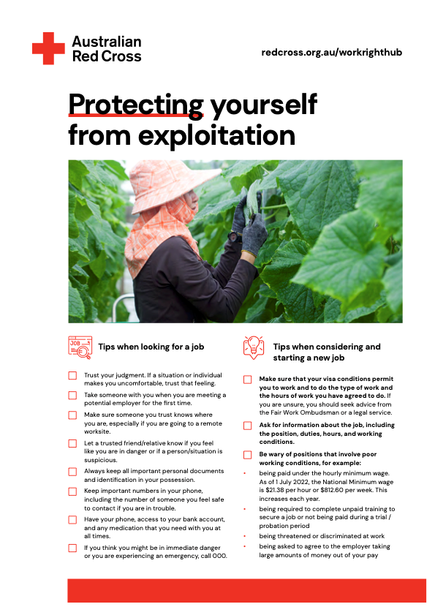
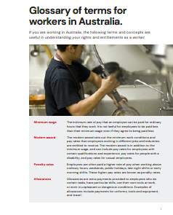
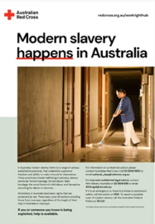
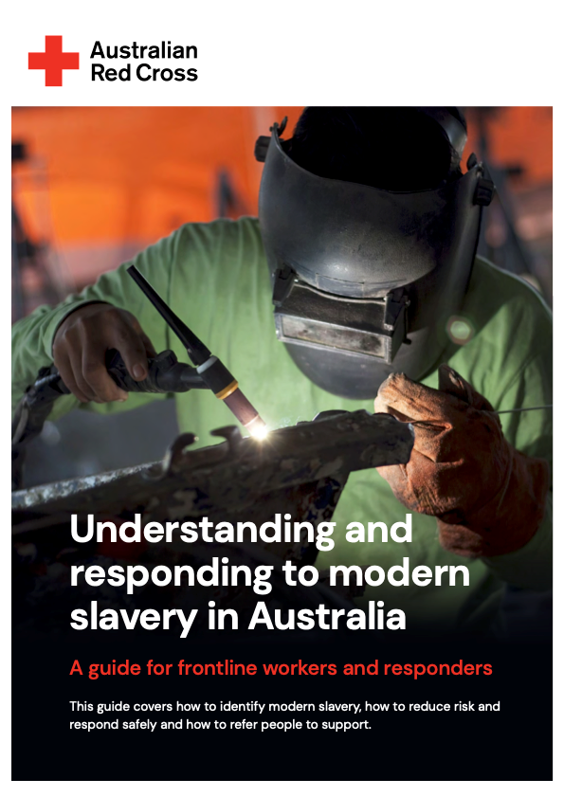

Toolkit Resources
These resources and assessment tools can be useful in sharing information, assessing indicators, and identifying relevant support agencies.
Protecting yourself
Glossary of terms
Posters & Flyers
Pocket Guide
National Services Directory

Slide 33
Reflection & Discussion
What is something you've learned today?
What stood out for you?

Slide 34

Last updated: June 2023
Australian Red Cross
Migration Support Program – Support for Trafficked People Program
national_stpp@redcross.org.au
1800 113 015
redcross.org.au/workrighthub
facebook.com/AustralianRedCross
@redcrossau
youtube.com/AustralianRedCross

