Slide 1
Terms of Use
This resource must only be used for internal training purposes. It is provided on an “as-is” basis and should not be relied on as a substitute for obtaining legal advice or conducting independent research. If updates are required in the future, you should only use the updated version to maintain reliability. Full terms of use are set out in the training Delivery Guide.

Slide 2
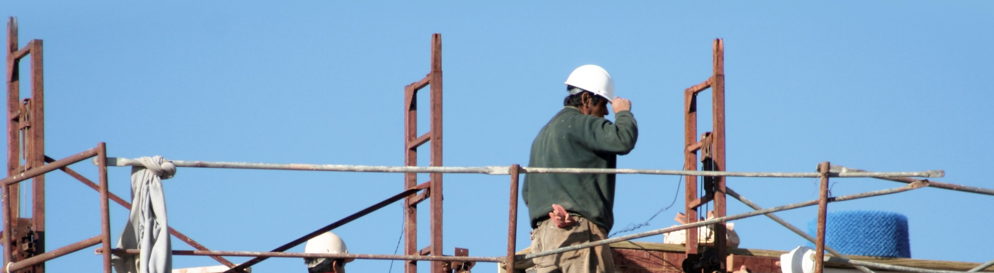
Labour Exploitation in Australia
Labour Exploitation | Modern Slavery | Work Right Hub
Notes:
Today is an introductory training session on labour exploitation, modern slavery and the Australian Red Cross online resource, the Work Right Hub. These are huge topics to explore in detail, however today will just be a start in understanding what these terms are, how to identify them in the workplace and community, how to respond. You will receive information about further tools and resources to explore to continue learning and refer to at any point in time.

Slide 3
Red Cross pays our respects to the Aboriginal and Torres Strait Islander Custodians across this country, and to Elders, past, present and emerging.
Notes:
We start by paying our deep respects to the Aboriginal and Torres Strait Islander custodians on the lands we are all on today. We acknowledge that First Nations communities have survived practices of modern slavery which continues to impact people and communities currently. I pay our respects to elders past and present. We celebrate the deep and enduring connection of Aboriginal and Torres Strait Islander peoples to country and acknowledge their continuing custodianship of the land, seas and sky.

Slide 4
Training Objectives
This training will provide opportunities to:
1
Improve awareness of labour exploitation and modern slavery in the Australian context
2
Recognise risks and indicators
3
Learn how to respond
4
Build knowledge of the Work Right Hub, supports, resources and referral pathways

Slide 5
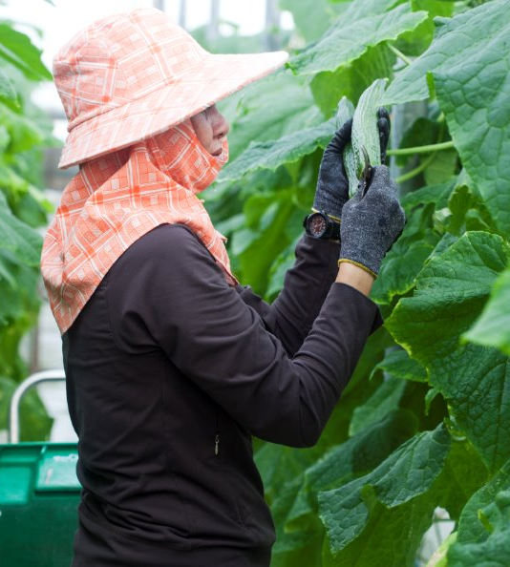
Introductions
What is one thing that you would like to learn today?
Notes:
These topics can be sensitive, so as a group we commit to being respectful to each other. Please feel free to take a break from the training at any point in time. Although not explored in this training, if there is any personal information shared today, we ask that it please remain confidential. Questions are very welcome. Training is only effective when we can put it into practice to make a difference in our communities and workplaces. So we ask that throughout the session, you identify at least one commitment that you can make to responding to labour exploitation and modern slavery.
We ask that you save them the end of the session, as we may answer the queries you have with throughout the presentation.
Before we start, if you could please introduce your self and one thing that you are interested in or hoping to learn more about today.
*Note – presenters are free to be open to questions throughout if they prefer. In the interests of time, it can be useful to reserve time for questions at the end instead.

Slide 6
Introductions
End of session: What is one commitment you can make to combatting exploitation and modern slavery?
Notes:
These topics can be sensitive, so as a group we commit to being respectful to each other. Please feel free to take a break from the training at any point in time. Although not explored in this training, if there is any personal information shared today, we ask that it please remain confidential. Questions are very welcome. Training is only effective when we can put it into practice to make a difference in our communities and workplaces. So we ask that throughout the session, you identify at least one commitment that you can make to responding to labour exploitation and modern slavery.
We ask that you save them the end of the session, as we may answer the queries you have with throughout the presentation.
Before we start, if you could please introduce your self and one thing that you are interested in or hoping to learn more about today.
*Note – presenters are free to be open to questions throughout if they prefer. In the interests of time, it can be useful to reserve time for questions at the end instead.

Slide 7
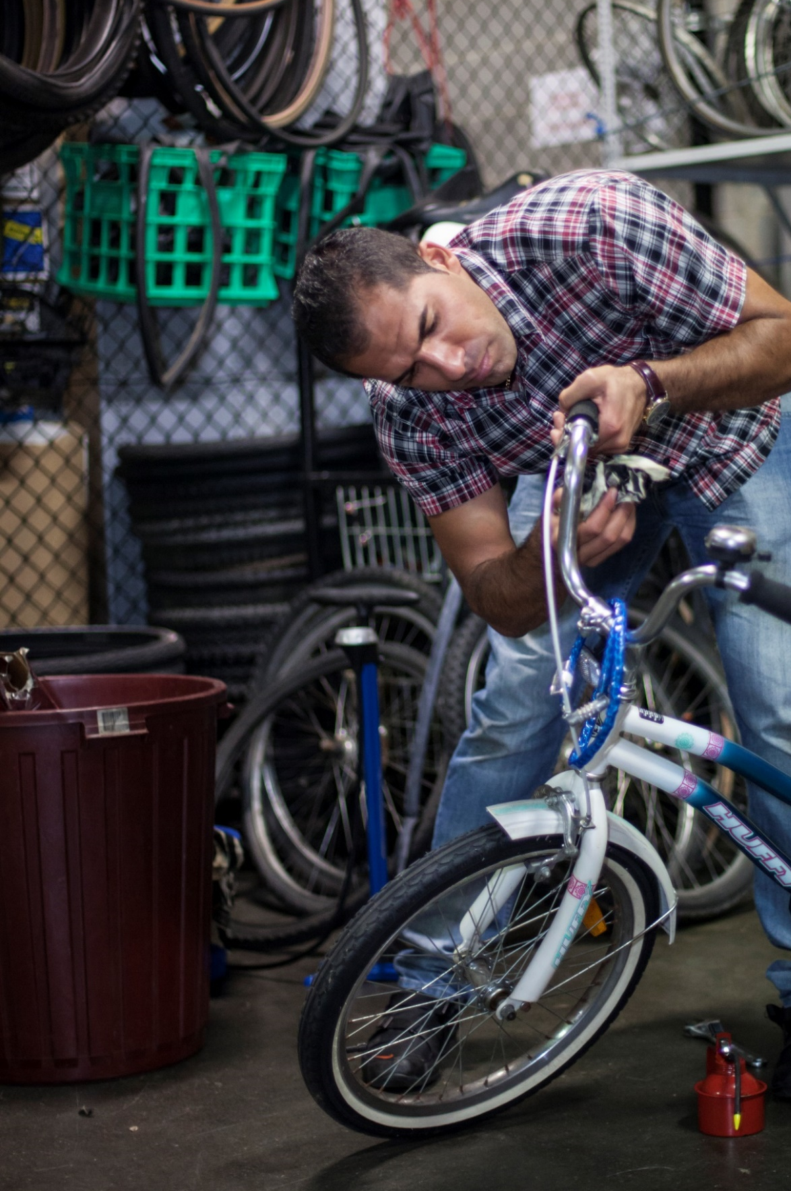
What is Labour Exploitation?
Notes:
What comes to mind when you think of the words Labour Exploitation? What are some words that you associate with it?
*At least 2 or 3 responses are adequate. Trainer to write the responses on the board (web based or physical)

Slide 8
What is Labour Exploitation?
Exploitation of labour involves taking unfair advantage of another person, their vulnerability or their situation for one's own benefit.
There is often a significant imbalance of power between the employer and worker.
Notes:
Although there is no nationally or internationally agreed upon definition, labour exploitation can generally be understood as:
- Someone taking unfair advantage of another person or their vulnerability, for their own benefit.
There is often a significant imbalance of power between the worker and their employer.
Labour exploitation can also happen in social or intimate/family relationships as well, not just in situations where there is a formal employment relationship.
[Note: At this point, it may be common for participants to begin to reflect on situations they have come across either in their work or personal lives and start to question if these situations amount to labour exploitation. The trainer can encourage this reflection; however, suggest that questions of this nature are held until later in the training.]

Slide 9
Labour Exploitation – poor work conditions or modern slavery?
Continuum of Exploitation
Fair work conditions
Poor work conditions
Modern slavery practices
Decent work
Fair treatment
Labour rights
Respected
Appropriate pay
Discrimination
Underpayment
Labour rights not respected
Limited safeguards
Restriction on freedom
Severe violation of human rights
Deception and/or coercion
* Modern slavery is not just bad or poor work conditions, such as being paid incorrectly or working in harsh environments – although these elements could be part of modern slavery practices.
Notes:
Labour exploitation can be understood as a spectrum. There are different types of labour exploitation that range from poor work conditions to conditions amounting to modern slavery where a person is not free to stop working or leave their place of work. On the left of this spectrum, we see fair work conditions that included fair pay and treatment. Then we see the continuum of exploitation commence, with poor work conditions such as underpayment and excessive working hours. These are unfair work practices that can be in breach of workplace laws for which can be investigated and depending on the breach, employers can face penalties fines, or imprisonment.
As we move toward the right- hand side of the continuum of exploitation, conditions get increasingly worse and become modern slavery. Key factors in modern slavery situation is force. Someone is not able to leave their work or change their work conditions because of deception, coercion or threats.

Slide 10

Modern slavery refers to a range of practices that involve coercion, threats or deception to exploit people and deprive them of their freedom. These practices include forced labour, trafficking, debt bondage, forced marriage, servitude and slavery.
These are serious crimes globally and in Australia.
It is estimated that there are 41,000 people living in modern slavery in Australia.
However, only 1 in 5 victim-survivors in Australia are identified.
Defining Modern Slavery
Notes:
Modern slavery refers to a range of practices that involve coercion, threats or deception to exploit people and deprive them of their freedom. These practices include forced labour, trafficking, debt bondage, forced marriage, servitude and slavery.
These are serious crimes globally and in Australia.

Slide 11
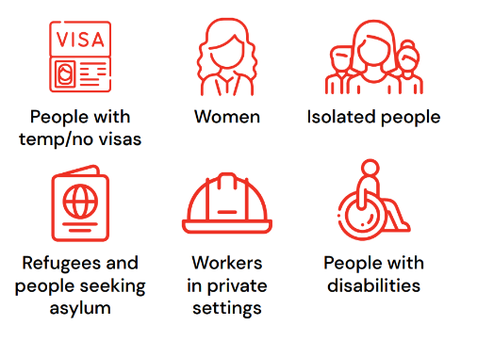
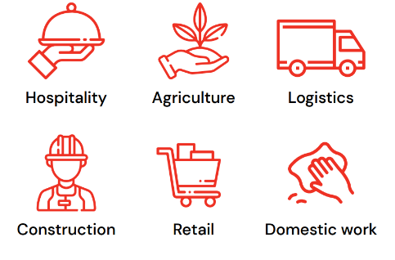
High risk industries and groups
Labour exploitation and modern slavery can happen anywhere in Australia. It occurs in different regions and within different industries. It happens in commercial workplaces and private homes. Jobs considered high risk include, but not limited to:
Modern slavery can happen to anyone, but those at higher risk include:

Slide 12
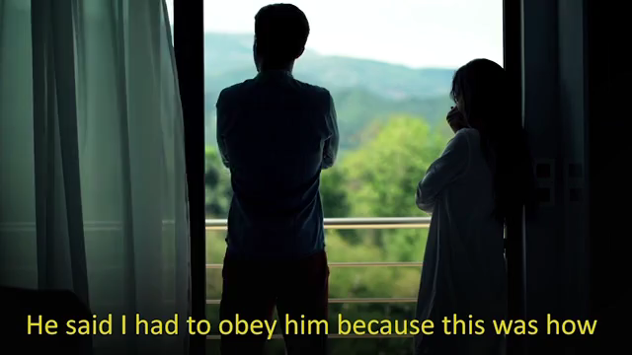
Notes:
Let’s watch this short clip which recaps what we have discuss so far and concludes with some of those key risk factors and barriers faced by migrant workers.

Slide 13

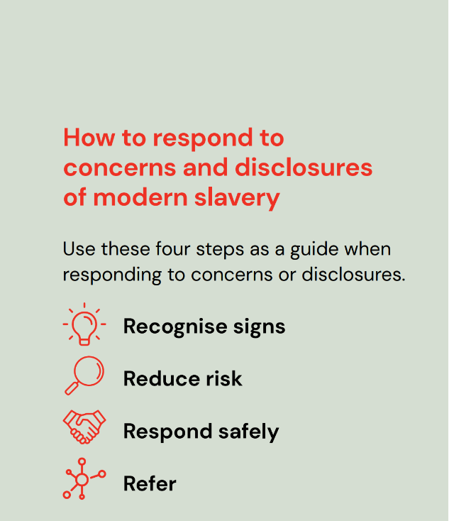
Notes:
In order to prevent, respond to, and support someone experiencing exploitation and modern slavery, it is important for us to be able to identify the signs, reduce the risks for that person in seeking help, respond safely in a trauma-informed manner, and know where and how to refer them to specialised supports that are available.

Slide 14
Recognise the Signs
01

Slide 15
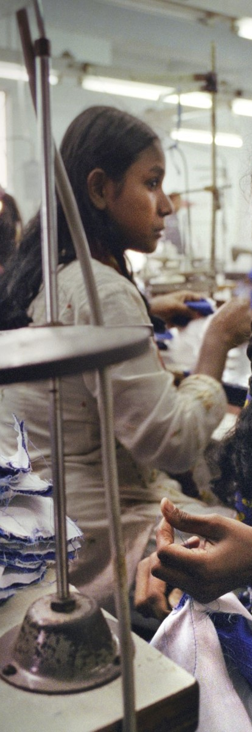
Step 1: Recognising the signs
Key questions
  Is the person free to leave or stop working?
  Has the person been coerced or deceived in any way?
  Has their personal freedom been affected by their work conditions?
  Are there any restrictions on the person's movement or communication?
If yes, they could be experiencing modern slavery.
Notes:
Speaking notes: The low rate of identification of victim-survivors connects to the phrase used for modern slavery, “hidden in plain sight”. When we think about what we can do to better identify the issue and support victim-survivors, the very first point is being able to recognise the signs.
. We will see that there can be many different indicators of modern slavery in the workplace, but keeping these 4 critical questions in mind is key.
Is the person free to leave or stop working?
Has the person been coerced or deceived in any way?
Has their personal freedom been affected by their work conditions?
Are there any restrictions on the person's movement or communication?

Slide 16
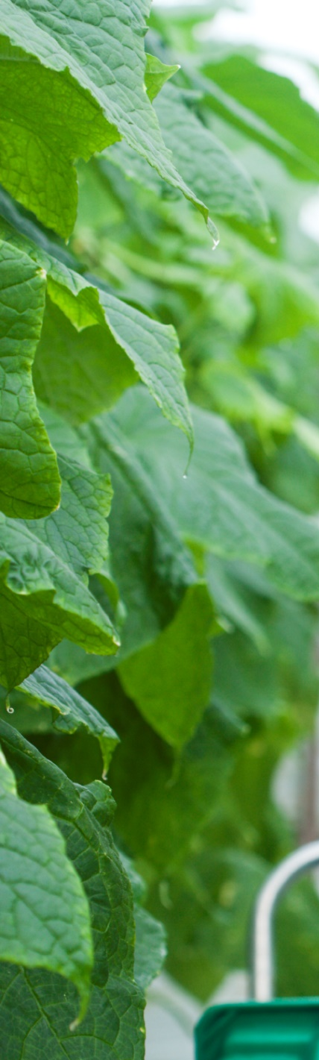
Case study | Mina
Mina has been sponsored to work in Australia on a temporary working visa. She works on a strawberry farm, making $10 an hour. Her boss tells her that she is not able to keep any of her earnings, as she needs to repay him $20,000 for the costs of sponsoring her and getting her a visa.
Mina is made to work 12 hours a day, 6 days a week. Her boss always goes with her when she wants to leave the farm to go to the shops or needed to see a doctor.
Mina's passport and visa documents are with her boss, who threatens to have her deported if she tells anyone about her work conditions.
Notes:
Let’s take a moment to look at Mina’s story as an example of circumstances you may come across.
Mina has been sponsored to work in Australia on a temporary working visa. She works on a strawberry farm, making $10 an hour. Her boss tells her that she is not able to keep any of her earnings, as she needs to repay him $20,000 for the costs of sponsoring her and getting her a visa.
Mina is made to work 12 hours a day, 6 days a week. Her boss always goes with her when she wants to leave the farm to go to the shops or needed to see a doctor.
Mina's passport and visa documents are with her boss, who threatens to have her deported if she tells anyone about her work conditions.

Slide 17






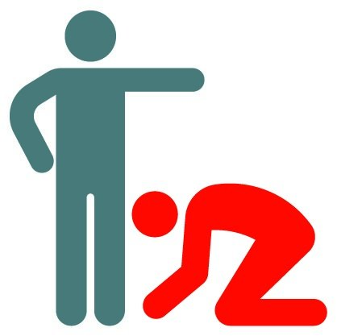
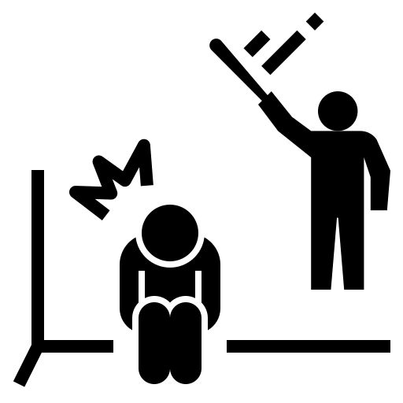


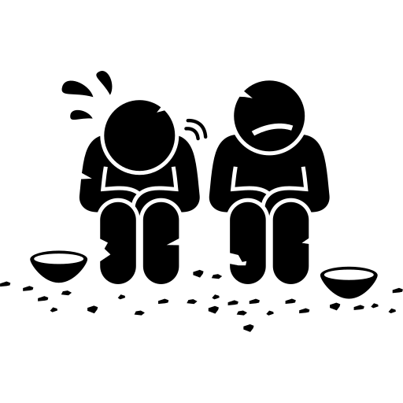

Indicators of Modern Slavery
Travel documents have been taken away
Feel unable to end employment/relationship at anytime
Labour is provided as security or to pay off inflated debt
Restricted freedom of movement, person is monitored, guarded or confined
Excessive hours of work
Withholding, underpayment or no payment of wages
No discretion over life decisions
Threatened and or actual physical or sexual violence
Deceived or lack of information about nature and conditions of work/stay
Living at the workplace or accommodation controlled by the employer
Abusive living and/or work conditions
Person is isolated: geographic, social or language
For a more comprehensive list of the indicators of modern slavery refer to the Australian Federal Police website – link here
Notes:
Here are some additional indicators involved in cases of exploitation and modern slavery.

Slide 18
Case study | Mina
Mina has been sponsored to work in Australia on a temporary working visa. She works on a strawberry farm, making $10 an hour. Her boss tells her that she is not able to keep any of her earnings, as she needs to repay him $20,000 for the costs of sponsoring her and getting her a visa.
Mina is made to work 12 hours a day, 6 days a week. Her boss always goes with her when she wants to leave the farm to go to the shops or needed to see a doctor.
Mina's passport and visa documents are with her boss, who threatens to have her deported if she tells anyone about her work conditions.
What indicators can you identify?
Notes:
Let’s take a moment to look at Mina’s story as an example of circumstances you may come across.
Mina has been sponsored to work in Australia on a temporary working visa. She works on a strawberry farm, making $10 an hour. Her boss tells her that she is not able to keep any of her earnings, as she needs to repay him $20,000 for the costs of sponsoring her and getting her a visa.
Mina is made to work 12 hours a day, 6 days a week. Her boss always goes with her when she wants to leave the farm to go to the shops or needed to see a doctor.
Mina's passport and visa documents are with her boss, who threatens to have her deported if she tells anyone about her work conditions.

Slide 19
Reduce Risk
02

Slide 20
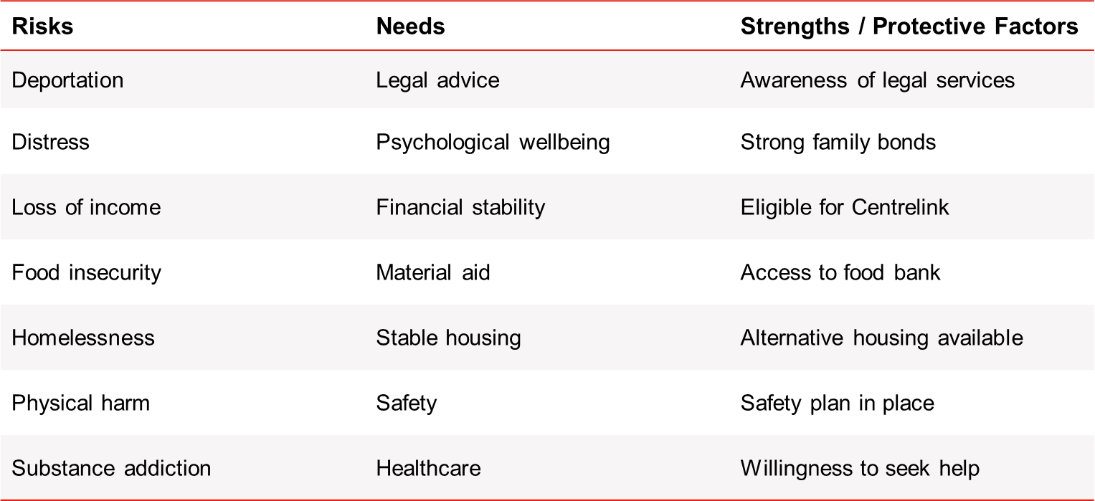
Step 2: Reduce Risk
When responding to concerns or disclosures of exploitation, it is important to develop a holistic understanding of the person's situation by assessing risks, needs, strengths and protective factors. This is an ongoing process, as these factors are likely to shift and change over time.
Notes:
When responding to concerns or disclosures of exploitation, it is important to develop a holistic understanding of the person's situation by assessing risks, needs, strengths and protective factors and this is what reducing risk is all about.
- In terms of risk, we need to assess factors that could endanger or further harm the person.
- Assessing needs means identifying what needs to be addressed as a priority, in the short-term and in the long-term, making sure that urgent and safety needs are addressed before working towards longer term goals.
- The person is the the experts in their situation and what they need. Identifying strengths can also help reduce risks and protect the person.
If we look at these examples and relate them to Mina’s experience:
What risks are indicated in Mina’s story?
[Trainer can encourage the following responses from participants for example:
Deportation
Distress
Homelessness
What needs might she have?
[Trainer can encourage the following responses from participants for example:
Healthcare
Material aid
Psychological wellbeing
Financial stability
Safety
Stable housing
What might her strengths be?
Willingness to seek help
[Trainer can revert to the Case Study: Mina slide if participants need to refer to it again.]

Slide 21
Respond Safely
03

Slide 22
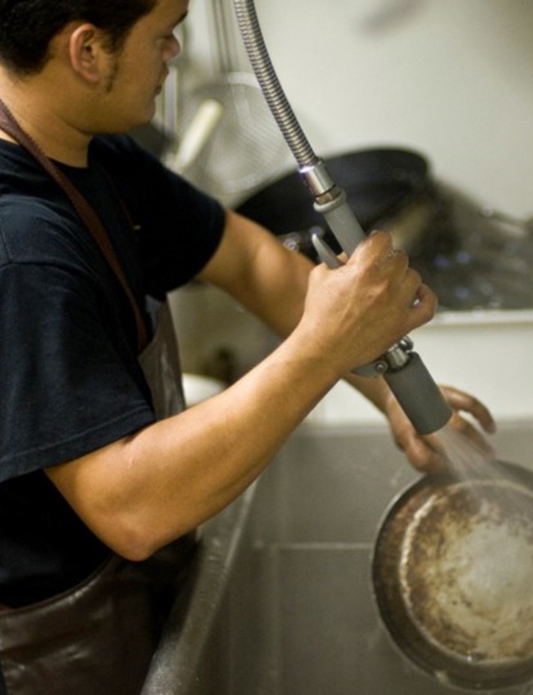
Step 3: Respond Safely
Safety Planning
Strategies for safety
Safety planning is the process of identifying strategies to promote safety for the person at risk of exploitation, and the services involved in supporting them. Safety planning is mainly informed by an individual's assessment of their risk factors and developed through a process of collaboration with the person providing a response.
Providing emergency contact numbers and details of support services.
Identifying friends or family members who could assist in the event of an emergency.
Sharing concerns with a supervisor and escalating issues in a timely way.
Discussing a safe location the person to go to if they are in danger.
Identifying a secure place for the person to store valuables in case they need to access them immediately.
Choosing safe methods to communicate with the person (e.g. emails rather than texts).
Discussing cyber/online safety (e.g turning off location settings, getting a new phone and number if possible, changing passwords for all online accounts).
Planning measures to protect any children involved.
Notes:
Speaking notes: Now we are up to the third step, which is responding safely.
Safety planning is a key component of this step. It is a process where we map out strategies to minimise risk and promote someone’s safety and the safety of the services that are involved. Safety planning is mainly informed by an individual’s assessment of their risk factors and developed through a process of collaboration with the person providing a response.
The following is a short list of popular strategies in safety planning. Whilst we’re reading them, consider which, if any you could consider implementing in a safety plan with Mina, and what else could be added.
Providing emergency contact numbers and details of support services.
Identifying friends or family members who could assist in the event of an emergency.
Sharing concerns with a supervisor and escalating issues in a timely way.
Discussing a safe location the person to go to if they are in danger.
Identifying a secure place for the person to store valuables in case they need to access them immediately.
Choosing safe methods to communicate with the person (e.g. emails rather than texts).
Discussing cyber/online safety (e.g turning off location settings, getting a new phone and number if possible, changing passwords for all online accounts).
Planning measures to protect any children involved.
[Trainer does not need to open for discussion or responses for this slide].

Slide 23
Refer
04

Slide 24

Step 4: Refer
Making referrals to appropriate service providers is a key step in connecting individuals with relevant assistance.
It is vital that this process is voluntary and shaped by the person, to promote strengths-based approaches and informed consent.
Notes:
The final critical step in responding and supporting someone is making referrals to appropriate services to connect them with relevant assistance.
This is crucial in connecting people to help.
This process must be voluntary, and the person at risk must provide informed consent before you refer them to another agency.
Considerations to make during this step when supporting someone such as Mina includes:
Communicating the role of services and what referral processes may look like.
Documenting consent where appropriate.
Services offered are tailored to the person's immediate, short-term and long-term needs.
Selecting credible and professional services.
Confirming eligibility criteria with services prior to making referrals.
Following up with the person to see how their experience has been with the service.
Storing information about the referral in a safe, ethical and confidential manner.
* BUT level of risk and duty care and safety needs to come first for reporting

Slide 25
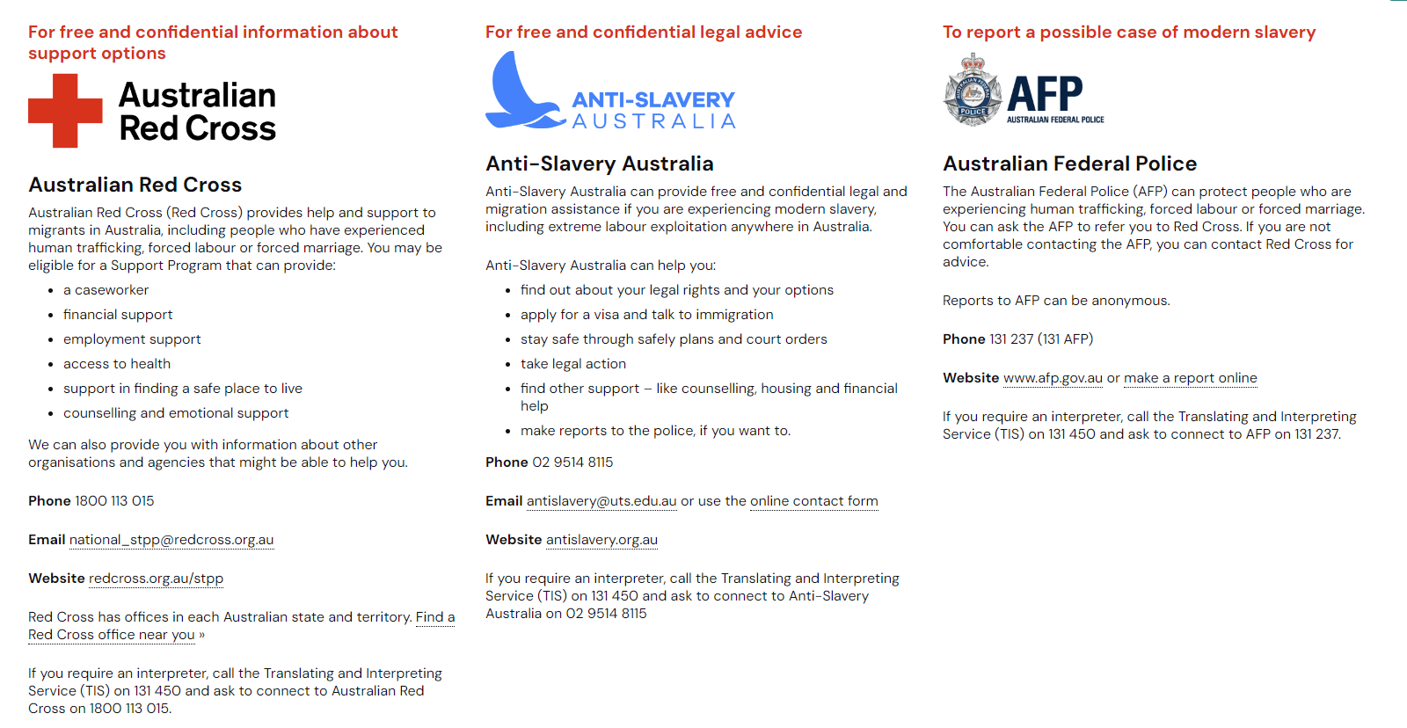
Key Referral Agencies
If the person is in immediate danger call 000
Notes:
There is a variety of support services you can refer to for help, however here are some key ones in relation to responding to modern slavery:
Australian Red Cross:
Australian Federal Police: The Australian Federal Police (or AFP) investigates cases of modern slavery. Currently, the AFP is the only agency that can refer suspected cases of modern slavery to the Support for Trafficked Program, which the Australian Red Cross delivers.
The AFP has a confidential reporting hotline that anyone can call and there is information about this process on the website. AFP’s reporting hotline is available 24 hours a day, seven days a week.
Anti-Slavery Australia: Anti-Slavery Australia (or ASA) is a legal centre that offers free and confidential legal advice to people who have experienced modern slavery, or people who might be at risk and want more information and advice about their options.

Slide 26
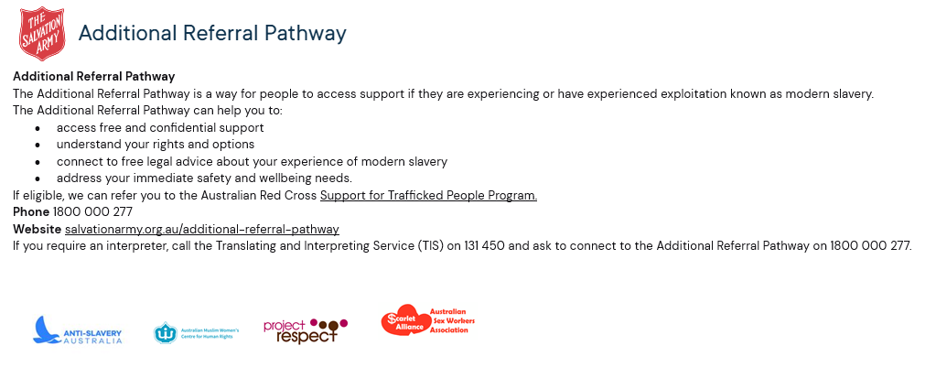
Key Referral Agencies
Notes:
Additional Referral Pathway:
Life Without Barriers:

Slide 27
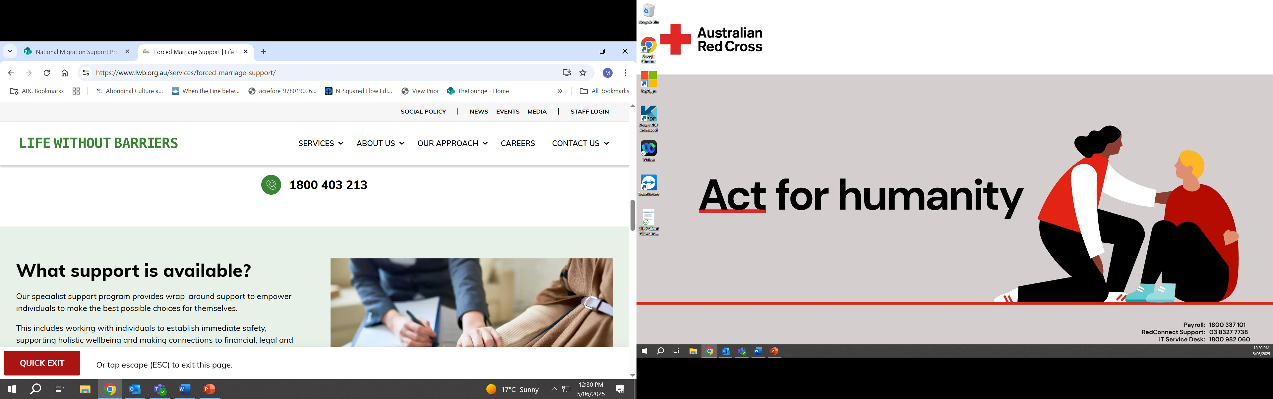
Key Referral Agencies
The Forced Marriage Specialist Support Program provides support for people at risk, in, or who have left a forced marriage.
Life Without Barriers can help you to:
establish immediate safety
access free legal, financial, and health support services
build pathways to independence through employment and education
work with families to re-establish connection and rebuild safer home environments
Phone: 1800 403 213
Website: www.lwb.org.au/services/forced-marriage-support/
If you need an interpreter, call the Translating and Interpreting Service (TIS) on 131 450 and ask to connect to the Forced Marriage Specialist Support Program on 1800 403 213.
Notes:
Additional Referral Pathway:
Life Without Barriers:

Slide 28
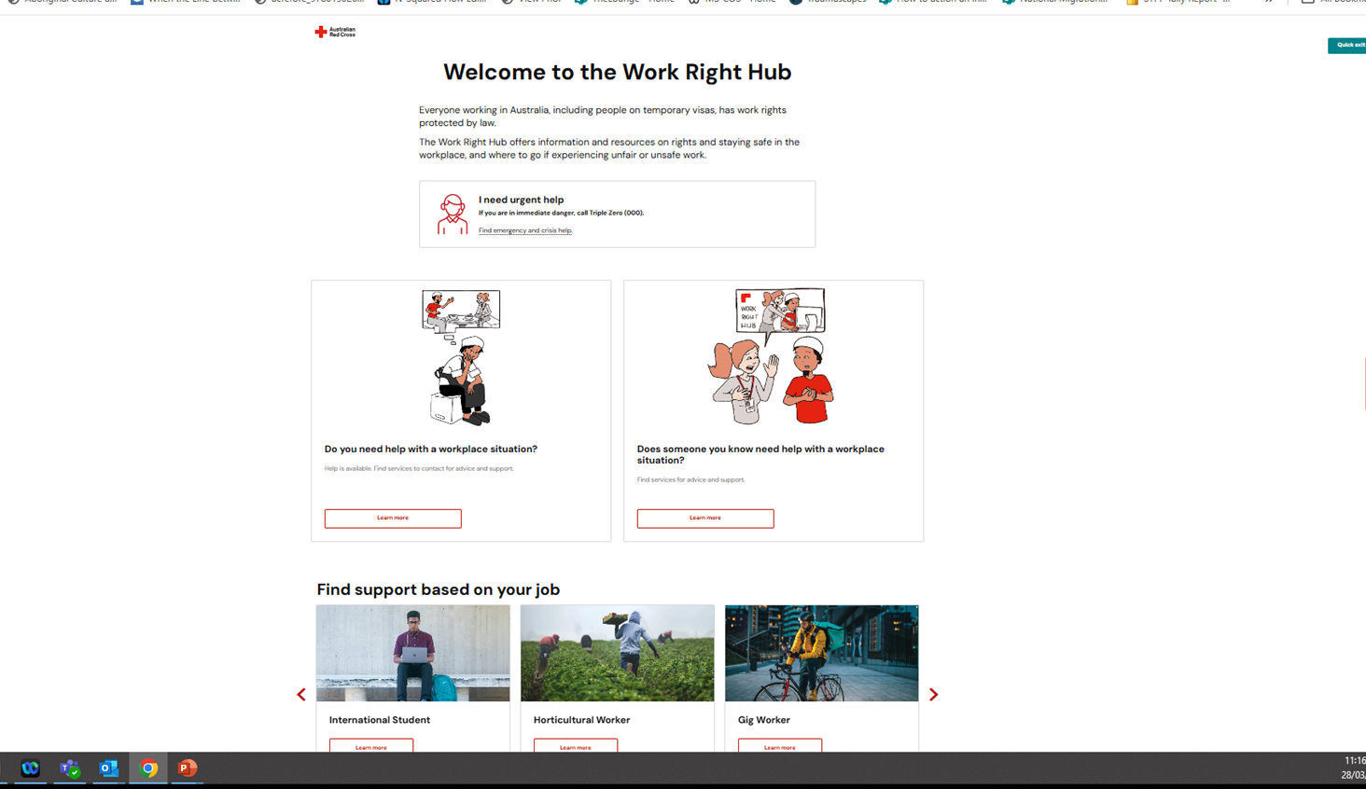
Work
Right Hub
www.redcross.org.au/workrighthub
Notes:
The Work Right Hub is funded by the Australian Government in response to a lack of resources and supports for migrant workers and those that support them in seeking help in situations of labour exploitation and modern slavery.
It has been developed alongside people from migrant backgrounds, and with lived experience of labour exploitation or modern slavery
It is a digital platform aimed at preventing and responding to labour exploitation in Australia. It aims to support migrants Recognise signs of labour exploitation
Understand ways to protect themselves
Find services for support.
It is also for community members and frontline workers to build their understanding of labour exploitation in the Australian context
Recognise risks and indicators of modern slavery
Respond to disclosures and concerns
Refer people to support

Slide 29
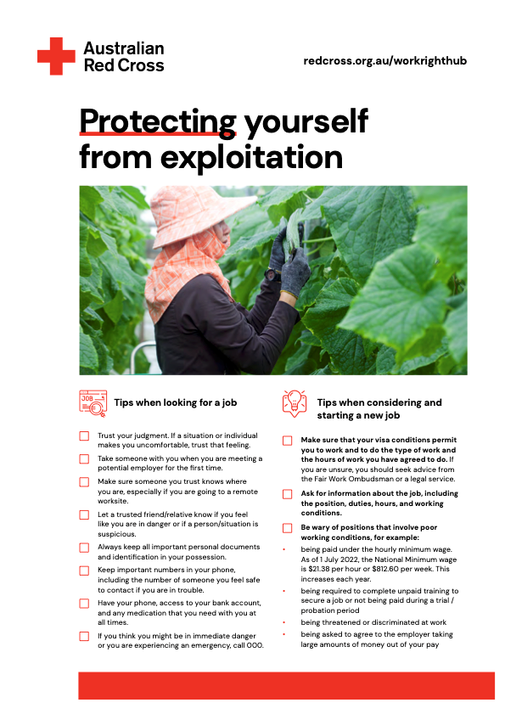
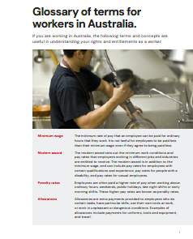
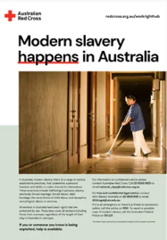
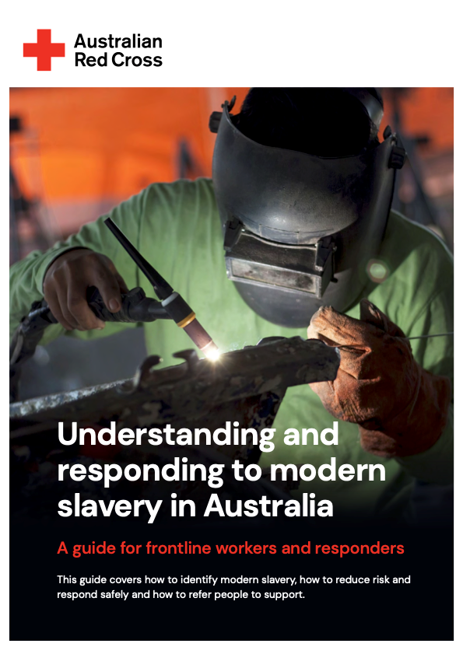

Work Right Hub Toolkit Resources
These resources and tools can be useful in sharing information, assessing indicators, and identifying relevant support agencies.
Protecting yourself
Glossary of terms
Posters & Flyers
Pocket Guide
National Services Directory
Notes:
Description: Trainer introduces and describes some of the resources available in the Work Right Hub, including the Toolkit to assist participants in assessment, response and referral processes.
Speaking notes: The resources in the Work Right Hub are designed to help us in identifying risks and indicators, sharing useful information with at risk people, and navigating which agencies to contact.
The resources have been developed by the Australian Red Cross and include:
A checklist of tips when looking for and considering a new job. These tips include keeping records of hours and conditions of work and being wary of positions that involve poor work conditions. This checklist has been translated into different languages.
A glossary of common workplace terms and concepts, such as compensation, penalty rates, and superannuation. These terms have been simplified and translated into some community languages, so they can be shared with people who might not be familiar with these concepts.
Posters and flyers with information on modern slavery and where to get support. These have been also translated into different languages.
A downloadable guide that covers how to identify modern slavery, how to reduce risk and respond safely and how to refer people to support.
National directory of organisations and agencies which can provide information and support to people experiencing labour exploitation.
And a free, self-paced e-module on ‘Understanding and Responding to Labour Exploitation in Migrant Communities’

Slide 30
Questions and Reflections
Questions
What is something you can do in the future to respond to modern slavery concerns?
Or
What was something you learnt today?

Slide 31
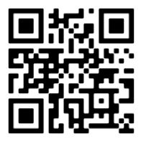
redcross.org.au/workrighthub
Australian Red Cross - National Anti-Trafficking Team
national_stpp@redcross.org.au
Explore the Work Right Hub for yourself
Notes:
Amend this according to Alia and Nat and what contacts they want shared

