Slide 1
Terms of Use
This resource must only be used for internal training purposes. It is provided on an “as-is” basis and should not be relied on as a substitute for obtaining legal advice or conducting independent research. If updates are required in the future, you should only use the updated version to maintain reliability. Full terms of use are set out in the training Delivery Guide.

Slide 2
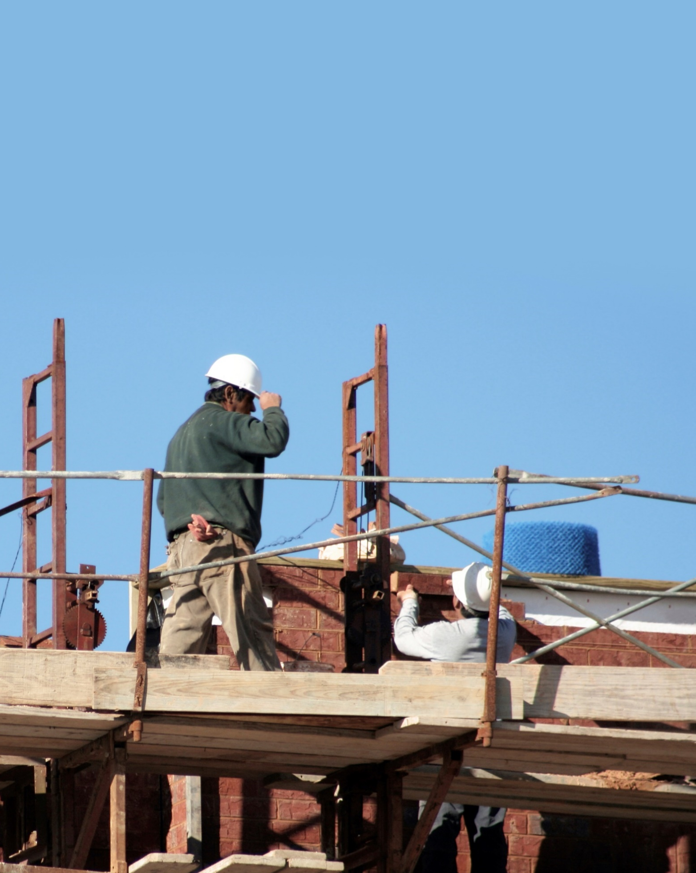
Labour Exploitation in Migrant Communities
Recognising signs | Responding safely | Providing support
Last updated: June 2023
Part One

Slide 3
Red Cross pays our respects to the Aboriginal and Torres Strait Islander Custodians across this country, and to Elders, past, present and emerging.

Slide 4
Training Objectives
This training will provide opportunities to:
1
Develop an understanding of labour exploitation in the Australian context.
2
Become familiar with a spectrum of exploitative practices.
3
Recognise risks and indicators of exploitation.
4
Identify key steps and good practice principles in responding to concerns or disclosures.
5
Consider strategies to employ safe, trauma-informed and culturally sensitive practice.
6
Become aware of referral pathways and key agencies.

Slide 5
Principles
Everyone has an opportunity to share
Questions welcome
Avenues available for feedback
Mindful of sensitive topics and conversations
Personal information not shared outside of this session

Slide 6
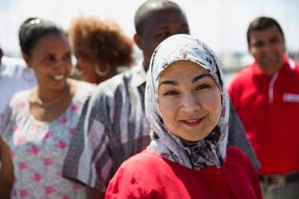
Introductions
Please introduce yourself and share one thing that you would like to learn today…

Slide 7
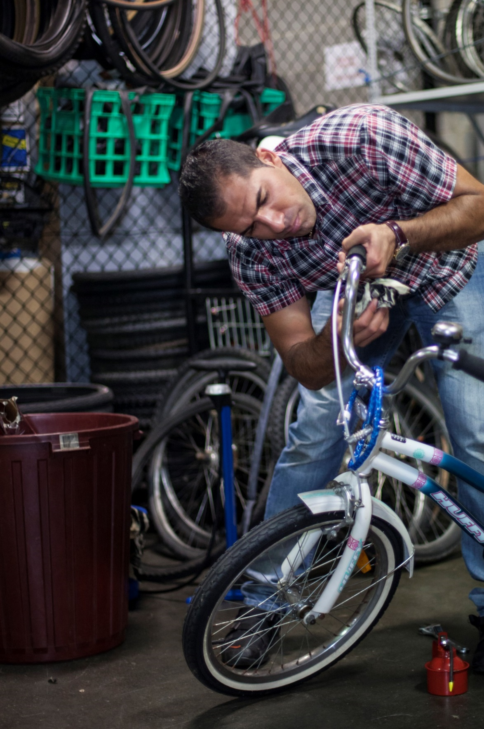
What is Labour Exploitation?

Slide 8
Defining Labour Exploitation
What constitutes unlawful labour exploitation in each country is defined in national labour laws and policies.
Exploitation of labour involves taking unfair advantage of another person, their vulnerability or their situation for one's own benefit. There is often a significant imbalance of power between the employer and worker.

Slide 9

Australian context
Labour exploitation happens across urban, regional and remote areas of Australia in a number of industries, both in commercial workplaces and private homes.
Hospitality
Agriculture
Logistics
Construction
Retail
Domestic work
  People exploited mostly by private enterprises or individuals.
  Migrants are at a higher risk of exploitation.
  Typically impacts those working in lower-skilled occupations.
Affected people are often reluctant or unable to self-report.
  Can involve complex personal relationships, and sometimes result in the serious undermining of personal freedom.

Slide 10
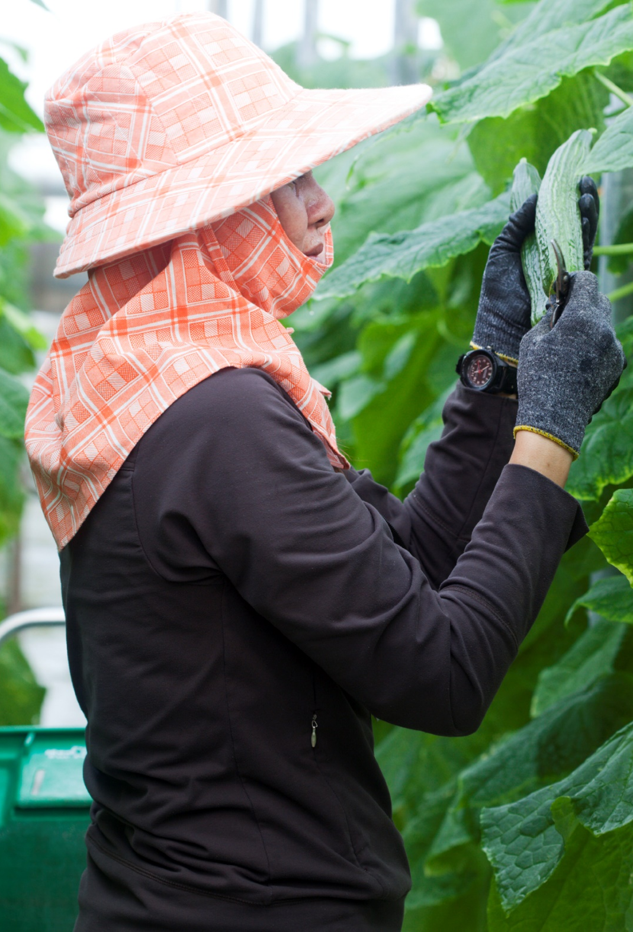
There are different types of exploitation, ranging from poor work conditions to conditions amounting to modern slavery.
These types of exploitation are not always separate and can often overlap.

Slide 11
Spectrum of Work Conditions
Continuum of Exploitation
Fair work conditions
Poor work conditions
Modern slavery practices
Decent work
Fair treatment
Labour rights
Respected
Appropriate pay
Discrimination
Underpayment
Labour rights not respected
Limited safeguards
Restriction on freedom
Severe violation of human rights
Deception and/or coercion
* Modern slavery is not just bad or poor work conditions, such as being paid incorrectly or working in harsh environments – although these elements could be part of modern slavery practices.

Slide 12
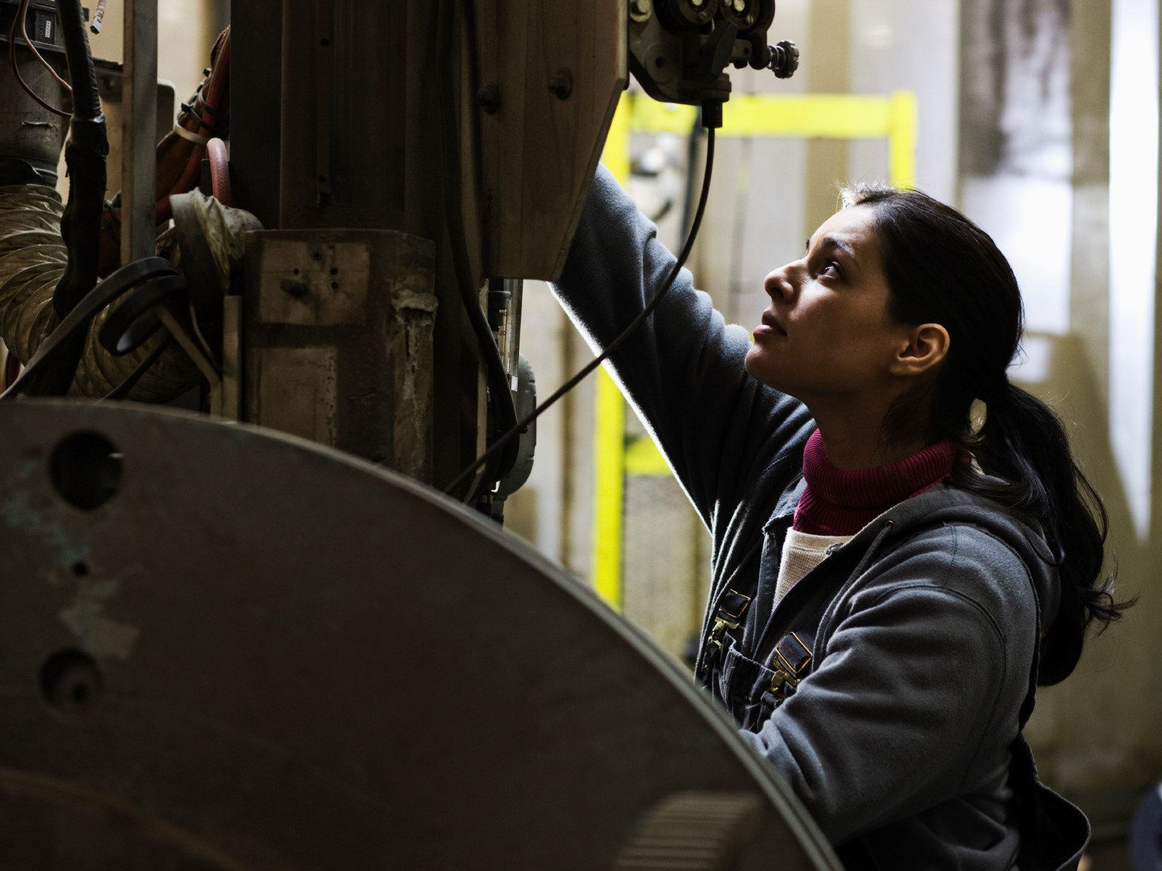
Risk Factors for Migrants

Slide 13
Risk factors
Labour exploitation can affect anyone, but a number of factors heighten the risk of exploitation for migrants.
These factors can accumulate and reinforce one another.

Slide 14
Pre-arrival factors
Different systems & employment practices
Lack of equitable access to education
Financial hardship (e.g. family or personal debt)
Exposure to corruption (e.g. infringement of rights,
marginalisation)
Conflict, displacement or other crises

Slide 15
Factors related to settlement journey
Limited English proficiency
Financial hardship
Limited social networks
Immigration status
Limited access to services
Limited knowledge of workers' rights, laws and systems
Challenges in transferring overseas qualifications
Unstable housing
Structural discrimination (e.g. gender inequality)

Slide 16
High risk groups
People with temporary/no visas
Women
Isolated individuals
Additional barriers to seeking and accessing help, gender-based violence.
Geographic or social isolation, disconnected from support networks, language barriers.
Limited access to services, desperation for work, fear of deportation.
People with refugee experiences
Workers in private settings
People with disabilities
Sudden migration, disrupted education, potential trauma or mistrust of authorities.
Occupations with low visibility and/or limited legal protections and regulations.
Potential health issues, additional levels of financial hardship and isolation.

Slide 17
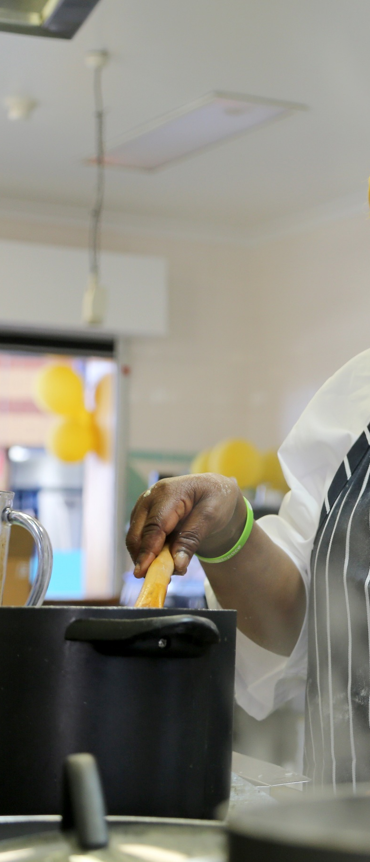
What are the risk factors?
Weh arrived on a and is studying Business Management in Australia. He wants to work while he studies to
that they have. Weh lives in a regional area where his university is based and
student visa
help his family overseas
repay some debts
doesn't have many connections there.

Slide 18
Maryam was a doctor in Iran, but
after her family was by local authorities. Now in Australia, she
and get enough work to
Shankar was a chef in India and works for his friend in Australia,
cooking and cleaning for his friend's family He
he should get paid or he should be working a day.
had to leave suddenly
persecuted
struggles to have her medical experience recognised
cover her family’s expenses.
in their home.
is not
sure how much
how many hours

Slide 19
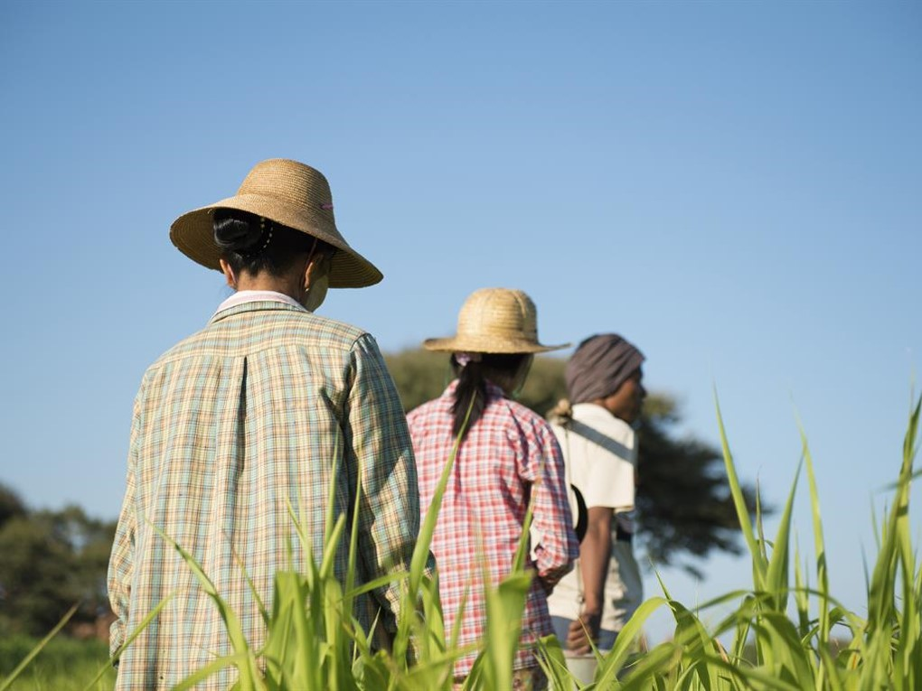
Labour Exploitation Practices

Slide 20
Poor Work Conditions
Continuum of Exploitation

Slide 21
Poor Work Conditions
Poor work conditions can include a variety of situations that do not uphold the protections set out in the law.
These conditions might include a single issue or a combination of issues relating to hours of work, leave entitlements, wages and penalty rates, health and safety, workplace relationships, and so on.

Slide 22
Example
Bisi works 10 hours a day, earning below the minimum wage. She doesn't receive any penalty rates for working overtime and does not have access to a payslip. She operates machinery in her role but has not been provided any safety equipment or training on how to operate these machines. Her employer is unwilling to make changes and tells her that she'll be fired if she reports them.

Slide 23
Modern Slavery
Continuum of Exploitation

Slide 24
Modern Slavery
“In Australia, modern slavery refers to a range of serious exploitative practices that undermine a person's freedom and ability to make choices for themselves. These practices include trafficking in persons, slavery, servitude, forced marriage, forced labour, debt bondage, deceptive recruiting for labour or services and the worst forms of child labour.”
- National Action Plan to Combat Modern Slavery 2020-2025

Slide 25
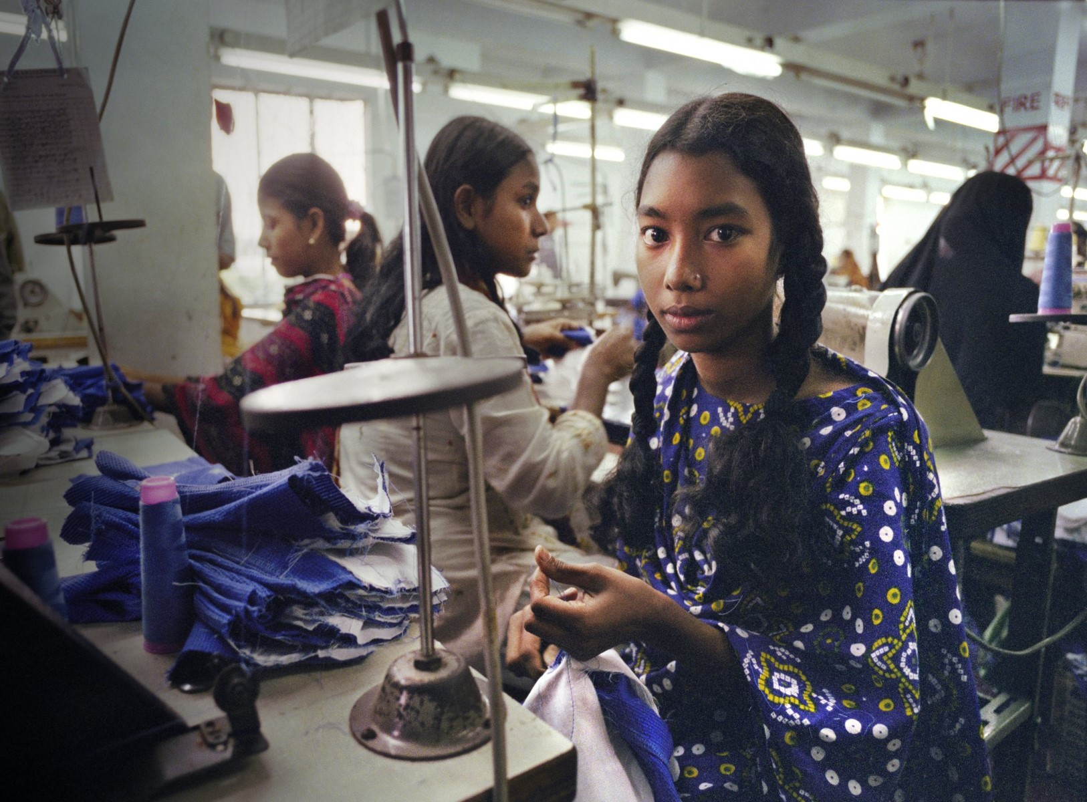
Slavery
“... the condition of a person over whom any or all of the powers
attaching to the right of ownership are exercised...”
‒ Criminal Code (Division 270)
In essence…
Someone treats another person like an object or property that can be purchased, sold or traded.
The offender behaves as though they own the victim and can use their labour in an unlimited way.

Slide 26
Trafficking in Persons
In essence…
Someone is recruited and transported through the use coercion, threat, or deception.
The ultimate aim is often to exploit them for profit.
"...the recruitment, transportation, transfer, harbouring or receipt of persons, by means of the threat or use of forced or other forms of coercion, of abduction, of fraud, of deception, of the abuse of power or of a position of vulnerability or of the giving or receiving of payments or benefits to achieve the consent of a person having control over another person, for the purpose of exploitation.”
- Trafficking Protocol

Slide 27
Debt bondage
In essence…
“... the status or condition that arises from a pledge by a person:
(a) of his or her personal services; or
(b) of the personal services of another person under his or her control;
as security for a debt owed, or claimed to be owed, (including any
debt incurred, or claimed to be incurred, after the pledge is given),
by that person if:
(c) the reasonable value of those services is not applied toward the
liquidation of the debt or purported debt; or
(d) the length and nature of those services are not respectively limited
and defined.”
‒ Criminal Code (Division 270)
Someone offers their services or someone else's services to repay a debt AND:
The person's services are not going towards reducing or eliminating the debt OR
There is no limit to the length and nature of the services, or it is not made clear.

Slide 28
Forced labour
In essence…
“... the condition of a person… who provides labour or services if, because of the
use of coercion, threat or deception, a reasonable person in the position of
the victim would not consider himself or herself to be free:
(a) to cease providing the labour or services; or
(b) to leave the place or area where the victim provides
the labour or services..”
‒ Criminal Code (Division 270)
A person is not able to leave their work or change their work conditions because of deception, coercion or threats.
Examples of coercion include isolation, intimidation and violence.

Slide 29
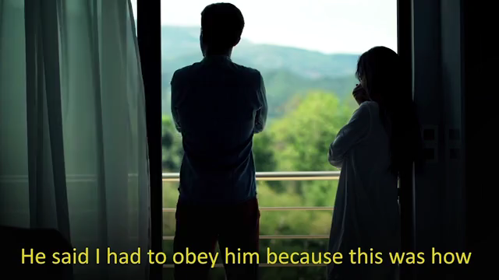

Slide 30
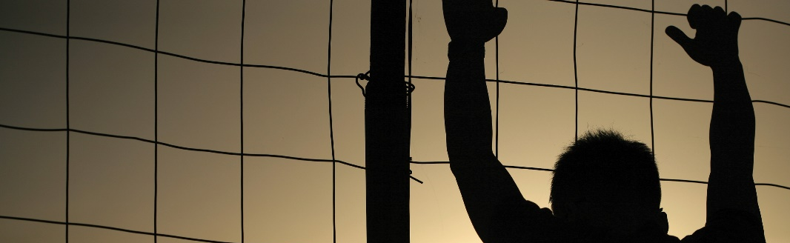
Servitude
A person is not able to leave their work or change their work conditions because of deception, coercion or threats AND their personal freedom is significantly restricted (e.g. they are not able to chose when they can eat or sleep).
Domestic servitude
Conditions that amount to servitude in a private household.
The person is subjected to degrading work conditions and their personal freedom is significantly restricted.

Slide 31


Slide 32
Reflection & Discussion
What stood out to you about the experiences shown in the two videos?
What similarities or differences could you identify between the two videos?

Slide 33
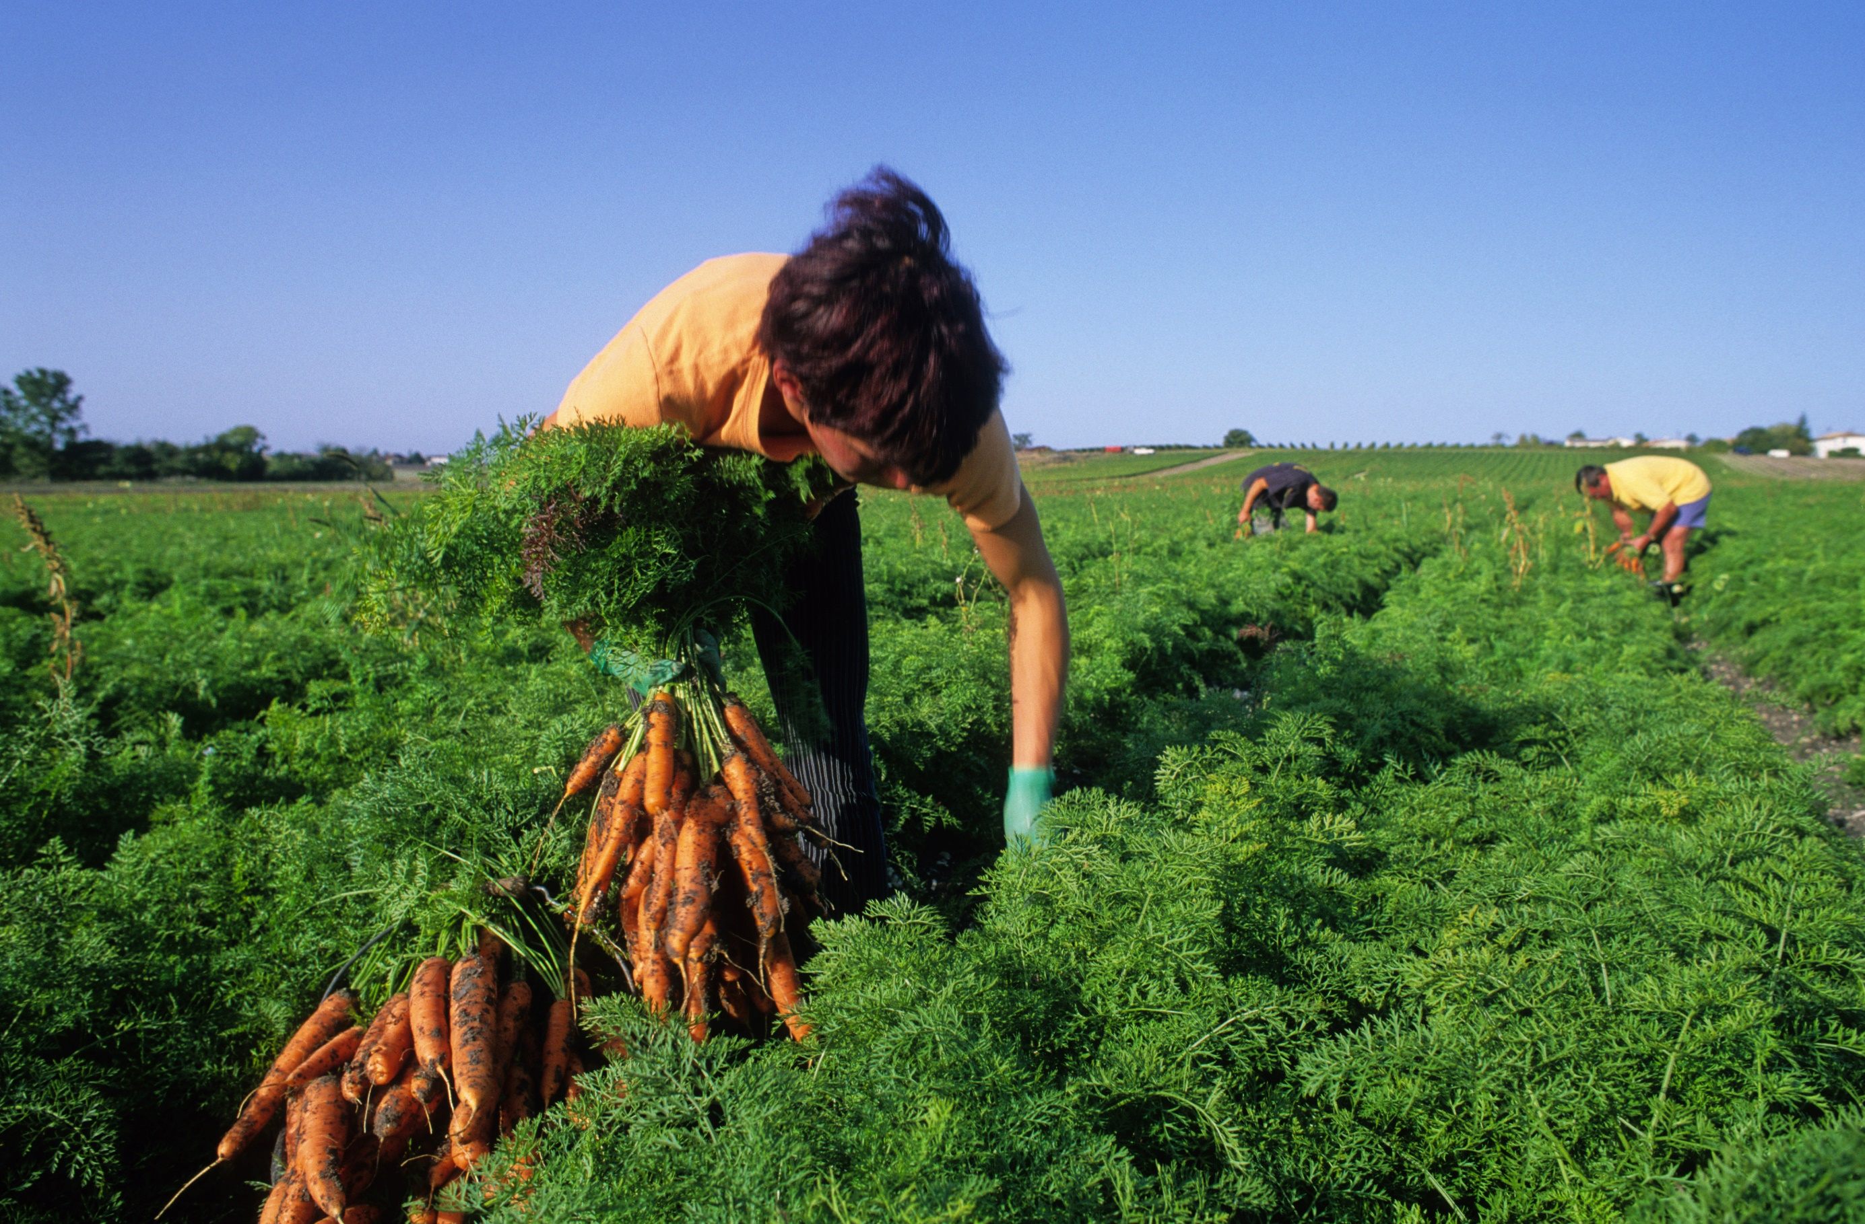
Indicators of Labour Exploitation

Slide 34
Assessing Indicators
The indicators in this section cover the main possible elements of labour exploitation and provide a basis to assess whether or not somebody is in a situation of labour exploitation.
The presence of one or more indicators in a situation might suggest the existence of labour exploitation. It is important to look at indicators in the context of individual situations, as there might be a variety of underlying reasons for these indicators.

Slide 35
Poor Work Conditions or Modern Slavery?
Modern Slavery Practices
Excessive debt
Coercion
Threats
Assault
Movement restrictions
Constant supervision
Sexual violence
Psychological control
Deprivation of basic needs
Confiscation of documents
Poor Work Conditions
Underpayment
Long work hours
Limited/no breaks
Unsafe practices
Limited/no leave
Lack of flexibility
No contract
Lack of role clarity
* Modern slavery practices may include indicators also seen in poor work conditions, but consist of additional indicators that point to coercion and/or deception.

Slide 36

Indicators of Poor Work Conditions
Psychosocial & behavioural
Afraid to speak about work or withdrawn when asked about work
Mistrust or fear of authorities, reluctant to report
Dependent on employer in some way
Discrimination
Social isolation
Emotional distress
Financial & material
Lack of penalty rates
Lengthy work trial or internship
Insufficient or no super/tax contributions
Underpayment, delayed or irregular pay
Worker incurs costs for tools, sponsorship, etc.

Slide 37
Indicators of Poor Work Conditions
Health & wellbeing
Unsafe or unsanitary work practices
Long work hours, limited or no breaks
Limited or no basic training
No insurance or compensation available for injuries
Legal
No contract or sham contract
Requesting info on rights & work conditions
Lack of clarity around role or work conditions
Lack of professional licenses
Unfair dismissal

Slide 38
When does it become Modern Slavery?
Although modern slavery practices may include indicators also seen in poor work conditions, there are a variety of additional signs that point to conditions of modern slavery.
Key questions
  Is the person free to leave or stop working?
  Has the person been coerced or deceived in any way?
  Has their personal freedom been affected by their work conditions?
  Are there any restrictions on the person's movement or communication?

Slide 39
Indicators of Modern Slavery
Not allowed to speak for themselves, need to get permission for regular activities
Threats of deportation, detention, violence, or harm to loved ones
Deprivation of basic needs (e.g. food, shelter, sleep, privacy)
Restrictions on movement and/or communication
Being constantly supervised
No access to or control of earnings
Made to consume alcohol or other substances
Psychological coercion (e.g. verbal abuse)
Physical/sexual assault (e.g. physical injuries, bruises)
Repaying large debt to employer or third party

Slide 40

Case study | Anthony
Anthony is seeking asylum in Australia and holds a temporary visa with no work rights. He has tried for years to survive on donations from charities and decides to take a job in construction to help him pay for rent and bills. Since taking the job, he has worked 45 hrs a week for 8 months as an unpaid trainee but hopes to eventually start earning money.
Anthony is not provided with appropriate protective gear like a helmet or gloves and has not received any training on the job. After injuring himself at work, he asks his boss for financial help to get treatment, as his visa does not allow him to access Medicare.
His boss tells him that he cannot help with medical expenses and that Anthony shouldn't expect to receive the same benefits as workers from other cultural backgrounds. When Anthony asks to get paid for his work, his boss tells him that he shouldn't ask about pay and that he can find another job if he wants wages.
Key questions
  What indicators can you identify?
  Does this sound like poor work conditions or modern slavery?

Slide 41
Case study | Anthony
Anthony is seeking asylum in Australia and holds a temporary visa with no work rights. He has tried for years to survive on donations from charities and decides to take a job in construction to help him pay for rent and bills. Since taking the job, he has worked 45 hrs a week for 8 months as an unpaid trainee but hopes to eventually start earning money.
Anthony is not provided with appropriate protective gear like a helmet or gloves and has not received any training on the job. After injuring himself at work, he asks his boss for financial help to get treatment, as his visa does not allow him to access Medicare.
His boss tells him that he cannot help with medical expenses and that Anthony shouldn't expect to receive the same benefits as workers from other cultural backgrounds. When Anthony asks to get paid for his work, his boss tells him that he shouldn't ask about pay and that he can find another job if he wants wages.

Slide 42

Case study | Mina
Mina has been sponsored to work in Australia on a temporary working visa. She works on a strawberry farm, making $10 an hour. Her boss tells her that she is not able to keep any of her earnings, as she needs to repay him $20,000 for the costs of sponsoring her and getting her a visa.
Mina is made to work 12 hours a day, 6 days a week. Her boss always goes with her when she wants to leave the farm to go to the shops or meet with her caseworker from a local service. Her boss sometimes hits her and sexually assaults her.
Mina's passport and visa documents are with her boss, who threatens to have her deported if she tells anyone about her work conditions.
Key questions
  What indicators can you identify?
  Does this sound like poor work conditions or modern slavery?

Slide 43
Case study | Mina
Mina has been sponsored to work in Australia on a temporary working visa. She works on a strawberry farm, making $10 an hour. Her boss tells her that she is not able to keep any of her earnings, as she needs to repay him $20,000 for the costs of sponsoring her and getting her a visa.
Mina is made to work 12 hours a day, 6 days a week. Her boss always goes with her when she wants to leave the farm to go to the shops or meet with her caseworker from a local service. Her boss sometimes hits her and sexually assaults her.
Mina's passport and visa documents are with her boss, who threatens to have her deported if she tells anyone about her work conditions.

Slide 44
End of Part One

